Slide 1


Mean (Average)
Firas Ben Thayer
Notes:
Hello Mentorness team! The topic of my reel is Mean or in other cases average.

Slide 2
Definition
Average : Common English Conversation.
Mean : There are multiple types of means such as the geometric mean, harmonic mean…
Notes:
Although they are synonymous. There is a slight difference solely in terminology between the terms:
Average is the sum of all the values divided by the total number of values. The term is often used in day-to-day English conversation.
Mean is a specific type of average and is calculated in the same way as the average by summing all the values and dividing by the count of values. However, the term “mean” is used more in a technical and mathematical sense. There are also other types of means such as the geometric mean and harmonic mean.

Slide 3
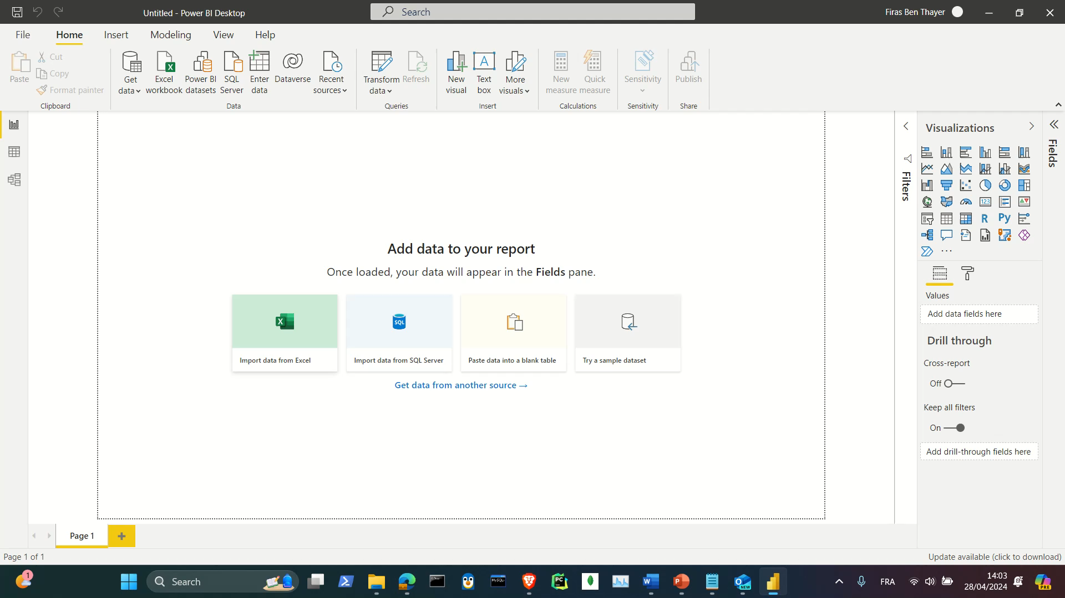
Small Demonstration
Notes:
Next, we’ll use Power BI to show a small demonstration of how average works. Pretty simple right?

Slide 4
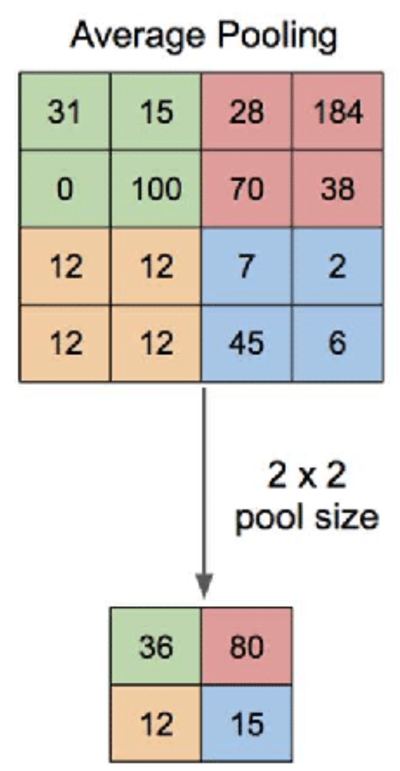
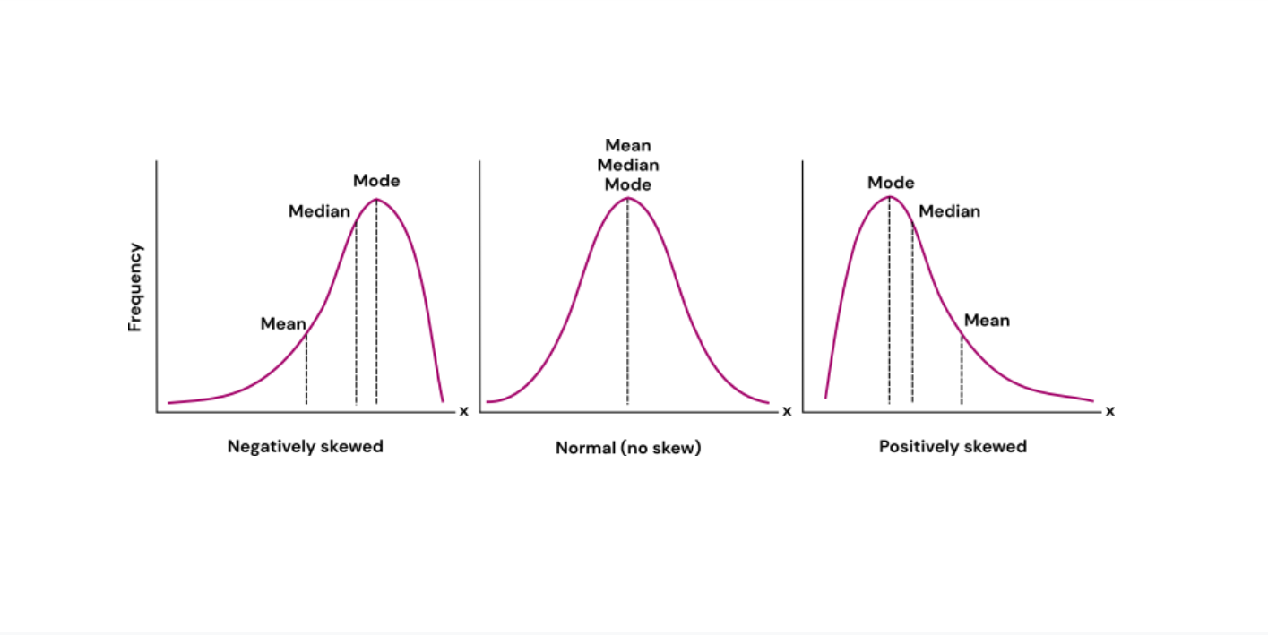
Uses
Notes:
Although average is a very simple formula. It is used in every sector of work from what you expect in finance or statistics to the unexpected. In deep learning, average pooling is used to get the average of a given kernel. It is generally used to reduce the complexity of the model.
The average can be used either directly or indirectly. For example, in Normal Distribution.

Slide 5
Examples
Temperature
Cost
Time
Notes:
We can see average used in all aspects of our lives. We just need to take a closer look. We talk about the average temperature, the average cost, or even the average time it takes to get to work, we’re using this fundamental statistical concept. It helps us understand and navigate the world around us, providing a simple summary of complex data.

Slide 6

Change Your Perspective!
Notes:
So, the next time you hear the word ‘average’, remember - it’s not just a number, it’s a story of the data, a snapshot of the whole picture. Statistics is not just about numbers; it’s about understanding the world around us. Thanks for watching!

